Slide 1
CA 3tera AppLogic

Slide 2

Agenda
CA and the Cloud
3tera AppLogic: Crossing the Cloud Chasm
AppLogic: An Infrastructure Virtualization Tool
Creating Cloud “Grids”
Opportunities for Web Services and eCommerce Providers
Customer Success
Q & A

Slide 3
Get Your Head INTO the Cloud a new way to manage technology
Roughly every 15 years there is a major inflection point in technology…
Cloud
Virtualization
Internet
Client-Server
The Cloud is a new way to deliver and consume technology
Mainframe
Cumulative nature of IT requires heterogeneous management
Notes:
We’re all seeing a tremendous amount of excitement about cloud, and with that comes hype, and from hype comes a fair amount of confusion. This is part of a pattern – about every 15 years there is a major inflection point in technology that in the short term can seem very disruptive, but ultimately out of the chaos emerges significant new efficiencies and benefits.
<build> The other part of this pattern is that the old technologies don’t go away, nor do they become less relevant. Each major technology change builds upon the ones that came before. In this way, cloud is like the other major technology changes – it builds upon those that came before. It’s obvious that cloud would be impossible without virtualization and the internet, but it’s also true that cloud, internet and virtualization all depend on distributed and mainframe environments. Taking advantage of cloud computing will require tools and approaches that bring all these environments together, whether it’s for managing the use of external cloud services within your service mix, or for providing your own cloud services.
<build> This is one reason why CA is ideally positioned to help companies like yours with cloud computing. For 30 years we’ve been extending our management capabilities to unify computing environments and approaches.
<build> But there’s one way in which cloud is different from all the other major technology shifts. Cloud isn’t a technology at all, but rather a delivery model. What’s is new is the management tools and approaches that bring it all together, taking many capabilities that are valuable in their own right and combining them in ways that create unprecedented agility, efficiency and business alignment.
This is why we believe that cloud isn’t so much a new technology to be managed, but rather a new way to manage technology.

Slide 4




Acquisitions Accelerate CA Cloud Strategy industry’s best integrated suite of ITM applications
CA has launched a dedicated Cloud BU focused on innovation in cloud delivery, consumption and value chain optimization
Mar ‘10
Mar ‘10
Sep ‘09
Jan ‘10
Oct ‘08
Jun ‘09
Notes:
CA’s 30-year commitment to IT management prepared us to invest in the right strategy at the right time…
3tera is the most recent, and one of the most important of these CA acquisitions . . . And it’s a true ‘game changer’ for both CA and its customers!

Slide 5
3tera AppLogic: a Bridge Across the Cloud Chasm
“…“Applications are generally the most successful offerings for crossing the chasm: they appeal to the line-of-business constituencies outside the IT department, who are most frustrated by the old model, and are most open to embracing new approaches.”
— “Crossing the Chasm,” Geoffrey Moore
“By 2012, customer spending on IT cloud services will grow almost threefold, to $42 billion…”
— IDC
“ Cloud model... 27% CAGR”
— IDC
“AppLogic eliminated over $350,000 in labor costs, freed up technical personnel to service our customers, lowered operation expenses and improved ops & support.”
— Todd Abrams, COO Layered Technologies
Notes:
3tera AppLogic is a bridge across the Cloud chasm, because as we’ll see, it’s a complete Cloud Computing Platform . . . But first, what (exactly) is “Cloud Computing”?
Cloud computing enables hosting providers to easily automate the deployment of customizable services. Hardware resources usage is flexible and each user can be scaled with a single command, without affecting other customers. AppLogic applications aren't limited to a single server so a single user can scale to multiple servers, making it easy manage multi-server configurations.
Cloud computing greatly simplifies managing resources and users. Because applications run in the cloud rather than individual specific servers, resources can be added or subtracted without affecting users. Even server failures are handled automatically by AppLogic without data loss.
Key point: the word “application” is extremely important in understanding 3tera AppLogic; we understand AppLogic as an application, but in “3tera terms,” an organized system of firewalls, gateways, routers, switches, servers, databases, and other hardware, meant to enable a complex IT service, is called an “application.”
*IDC – “Worldwide IT Cloud Services Spending, 2008-2012,” IDC, 2008

Slide 6
AppLogic: Complete Cloud Computing Infrastructure Platform
Service Providers
Intuitive User Interface
Data Centers Worldwide
#
#
On-Demand Scaling
Major Operating System Support
Integrated Monitoring
Universal High-Availability
IT Organizations
Business Continuity
Available for In-House Use
Embedded SAN
Efficient Resource Usage
Zero-Trust Architecture
Comprehensive Metering & Billing
All this plus the AppStore . . .
Notes:
AppLogic™ is the first turn-key commercial Cloud computing platform, designed from the grounds up to provide a complete infrastructure solution. The solution includes a grid operating system, integral IP SAN, intuitive user interface and a catalog with the most common infrastructure components and ready-made software stacks. This powerful combination will get any Web application up and running fast, whether as a service, or installed in your data center.

Slide 7
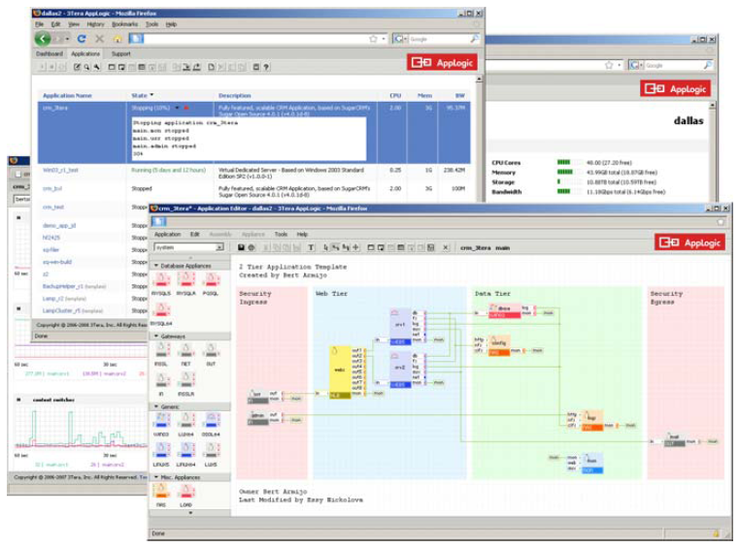
“Draw” Virtual Applications in a Web GUI define infrastructure, provision databases and servers
An infrastructure virtualization tool
AppLogic enables users to virtualize switches, load balancers, gateways, and other standard hardware devices as well as servers.
Treats infrastructure as a single object, called an ‘application’
Easily copy an entire end-to-end infrastructure, and modify the copied version without affecting the original. Migrate an application to another grid in another data center.
Automatically builds grids
Converts a grid of commodity servers into a scalable shared resource for running online applications
Notes:
AppLogic is an infrastructure virtualization tool, not just a server virtualization tool. This means AppLogic allows users to virtualize switches, load balancers, gateways, and other standard hardware devices as well as servers.
AppLogic treats Infrastructure as a single object, called an ‘application’. This enables users to easily copy an entire end-to-end infrastructure and even modify the copied version without affecting the original. This also allows users to migrate an application to another grid in another data center.
AppLogic converts a grid of commodity servers into a scalable shared resource for running online applications. In the cloud, a control panel, a virtual private server, a clustered database, or even a social networking system are all just applications. This enables providers to deliver shared hosting, virtual private servers (VPS), complex hosting environments and advanced applications from the same cloud. All without new equipment or people.
AppLogic supports Inheritance and Hierarchy. These two features create various possibilities within AppLogic. One example of what Inheritance means within AppLogic can be illustrated by the fact that any updates to appliances in the main catalogue will be inherited to appliances within applications. One thing that Hierarchy enables is the ability for users to change a property value at the appliance level as well as at the application level.

Slide 8
3tera AppLogic: Control, Agility, Ease operates on the logical structure of the application
Package an entire N‐tier application or service into a logical entity and manage it as a single system.
Control
Quickly assemble, deploy, monitor, control and troubleshoot applications visually in a Web browser through an AJAX‐powered interface.
No SANs, specialized networking equipment, management systems or other software is required, resulting in lower capital costs.
Agility
AppLogic is completely compatible with existing operating systems, middleware and web applications, and there’s no vendor lock‐in.
Ease
Notes:
Among the most advanced capabilities of AppLogic is it’s ability to package an entire N‐tier application or service into a logical entity and manage it as a single system. To make this possible, AppLogic captures and operates on the logical structure of the application, which makes it very easy to assemble, deploy, monitor, control and troubleshoot applications visually in a browser through an AJAX‐powered interface.
By embedding the infrastructure definition in your application, AppLogic turns the application into a self-contained, portable entity with absolutely none of the hardware bindings associated with traditional deployments or virtualization. This allows AppLogic to make resource allocation decisions at runtime. With no pre-defined resource bindings, applications become scalable. If business needs change, resources can be added or subtracted at will. The process can even be automated with our SL dynamic appliance.
Running applications on the AppLogic platform does not require any changes or modifications to the application code. Using advanced virtualization technologies makes AppLogic completely compatible with existing operating systems, middleware and web applications. Further, once defined on AppLogic, applications can easily be deployed back into standard physical architectures; hence there is no vendor lock‐in, a key issue for many customers.

Slide 9
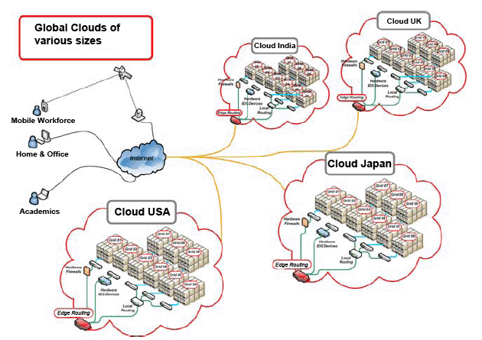
Instantly Deploy Applications to Global “Grids” or move entire applications and all saved data
Notes:
3tera has over 30 hosting partners, worldwide, running their data centers on the AppLogic platform. Any application currently running in an AppLogic environment is compatible with any data center powered by AppLogic. The system organizes resources by joining servers automatically into a grid that can be scaled at any time by simply racking additional commodity servers and Gigabit Ethernet switches; no SAN or specialized hardware is required.

Slide 10


Web Environments / eCommerce what would the cost savings be, if…
What if your app teams could be completely self sufficient in building, deploying, and destroying the infrastructure they need to build applications to support the business?
What if it all ran on commodity servers, at a fraction of the cost of your production-class hardware?
What if they could quickly and easily copy application revs, make changes, and move those applications to new phases of development on new infrastructure?
What if your infrastructure team only had to worry about managing your production application infrastructure?
Notes:
It’s vital to understanding Web Services and eCommerce Provider Pain Points, *AND* Application Delivery Pain Points (they’re closely related!)
Web Services and eCommerce Providers
Do you have content applications (marketing, customer facing, changing often) that require more agility in order to address the needs of your business? What if those applications could be brought to market in days vs. months?
Do you have hundreds of web applications running on every technology platform under the sun? What if you could offer the technology flexibility that those app teams require, but with the control you need to have in place?
CIO, CTO, Operations, App Owners
Ask how application developers interact with Infrastructure teams currently
Ask about the current go to market process for applications
How do developers get access to resources for app dev? Is it an automated process?
How long does it take? How do they restart and application test cycle? Do they have to re-engage with the infrastructure team?
What infrastructure is being used for app dev, test? Is it production cla$$? i.e. “Are you using your SAN, Production DB?”
Then ask these “what ifs” →
What if your App teams could be completely self sufficient in building, deploying, and destroying the infrastructure they need to build applications to support the business?
What if it all ran on commodity servers, at a fraction of the cost of your production-class hardware?
What if they could quickly and easily copy application revs, make changes, and move those applications to new phases of development on new infrastructure?
What if your infrastructure team only had to worry about managing your production application infrastructure?

Slide 11
With AppLogic, You Can empowers operators to manipulate entire applications
AppLogic virtualizes the entire infrastructure the application needs
Deploy, operate and scale online applications that are created & destroyed when they run
No SANs, specialized networking equipment, management systems or other software
AppLogic supports Linux and Microsoft Windows as well as Sun Open Solaris and Solaris 10
Notes:
With 3tera AppLogic, all of the “What ifs” on the previous slide are answered, “YOU CAN!”
Servers and AppLogic are the ONLY entities to deploy and manage. No SANs, specialized networking equipment, management systems or other software is required, resulting in lower capital costs at startup, provisioning and in operations.
AppLogic addresses the need to deploy, operate and scale online applications efficiently. To make that possible, the system virtualizes not the server, but the infrastructure the application needs in order to run. That infrastructure is made a part of the application, and is created and destroyed whenever the application runs. As a result, rather than operate on server images, AppLogic empowers operators to manipulate entire applications AND the infrastructure they depend on as a single entity.
AppLogic supports the most popular data center operating systems – Linux and Microsoft Windows as well as Sun’s Open Solaris and Solaris 10.

Slide 12
Opportunity: Improve Margins and Differentiate application stacks: Platform as a Service offerings
Install AppLogic as a technology platform to…
Shift from managing individual servers and software images to operating a cloud service (PaaS)
Package and offer Java, LAMP, Ruby on Rails, Microsoft .NET and other popular development stacks as scalable, highly‐available deployment vehicles for Web apps
Resell cloud solutions with your branding (“white label”) such as Virtual Private Servers, Virtual Private Data Centers, Cloud Storage, Application Stacks, etc.
Notes:
Shifting from managing individual servers and software images to operating a cloud service or a shared scalable grid allows hosting providers to efficiently scale existing lines of business and branch into new high margin services like offering cloud computing. All while providing customers low prices and scalability, which reduces churn, cost and time.
AppLogic is available to service providers in two ways:
1) As a technology platform that can be installed and run on your own servers and used to create a variety of cloud offerings,
2) As a white label offering in which you resell cloud solutions with your branding such as:
• Virtual Private Servers
• Virtual Private Data Centers
• Cloud Storage
• Application Stacks
• Managed Services
• Business Continuity …all powered by AppLogic and operated by 3Tera.
Partnering with the leader ensures your business will stay on the cutting edge of this fast moving space. 3Tera helps you constantly reinforce your brand with users. The OEM kit lets you customize the AppLogic user interface with your logos and links prominently throughout the AppLogic user interface.

Slide 13
AppLogic: Game-Changer for Service Providers significant reduction in infrastructure, labor costs
FASTER
Speed time to market
LOWER COSTS
Develop on virtual infrastructure rather than production
No SANs or other software needed
HIGHER AVAILABILITY
On-demand scaling
Build and destroy applications rapidly
Copy and re-use existing applications
Ensure business continuity
Deploy to Cloud-based grids worldwide
Updates automatically extended to all elements of an application
Notes:
Fastest time to market
Significant reduction in infrastructure overhead
High Availability – application developers no longer are dependent on infrastructure

Slide 14
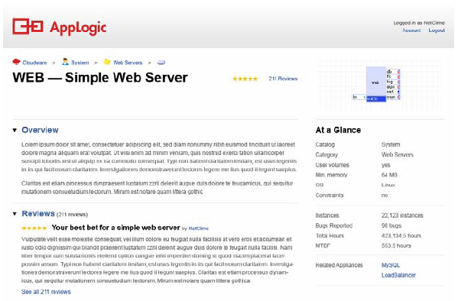
AppStore: Market for Supported Software Stacks offer your subscribers ready‐to‐use appliances
A globally available marketplace offering enterprise‐class, supported software stacks
Easy access to pre‐configured, ready‐to‐use appliances
Packaged for use in public, private and hybrid AppLogic cloud deployments
Adds value to your service
Notes:
The 3Tera AppStore adds value to your service by providing subscribers easy access to pre‐configured, ready‐to‐use appliances provided by trusted software vendors to add to their 3Tera AppLogic catalogs.
The 3Tera AppStore is a globally available marketplace offering enterprise‐class, supported software stacks, packaged for use in public, private and hybrid AppLogic cloud deployments.

Slide 15








Customer Success
Notes:
AppLogic Users/Customers:
Layered Technologies
AgathonGroup
Kualo
CariNet
DNS Europe
ScaleUp Technologies
Xseed
Cleargrid
They offer . . .
• Virtual Private Servers
• Virtual Private Data Centers
• Cloud Storage
• Application Stacks
• Managed Services
• Business Continuity

Slide 16
Q&A

